Slide 1
Creating an End to End Project: The Intersection between Data Science and Business Intelligence
Kendall Ruber – MIT Analytics Proseminar. 2024.

Slide 2
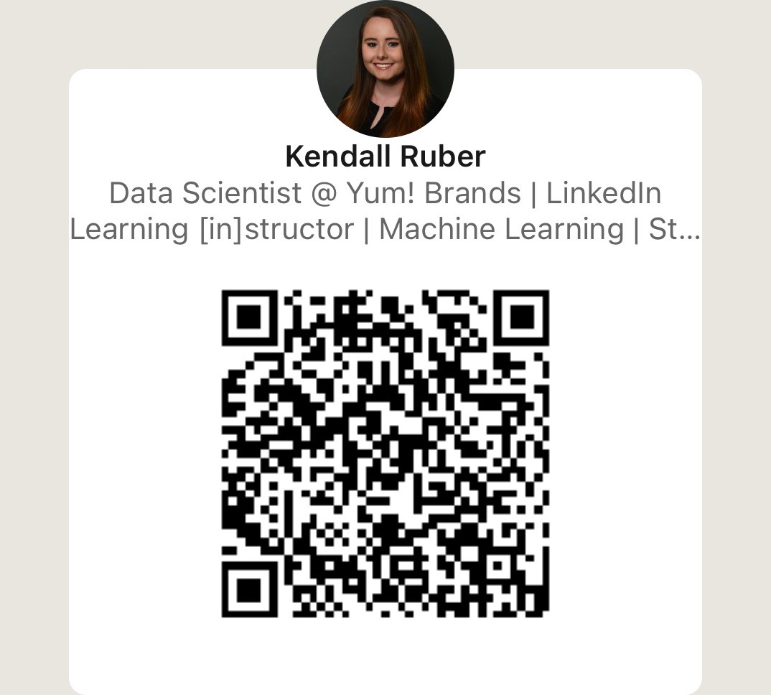
About Me
Education:
MS Business Analytics
BS Economics
BA Spanish
All from the University of Louisville!
Career:
Current: Data Scientist at Yum! Brands, focusing on demand forecasting, labor, and LLMs
Previous: Data Analyst/BI at LG&E & KU Energy focusing on reporting and NLP
Occasional: I’ve taught courses on Statistics and Databases at the university level and for LinkedIn Learning
Notes:
Before getting started, I would like to provide a background about myself------
I’ve worked in the Utility and Quick Service Restaurant industries
Transition

Slide 3
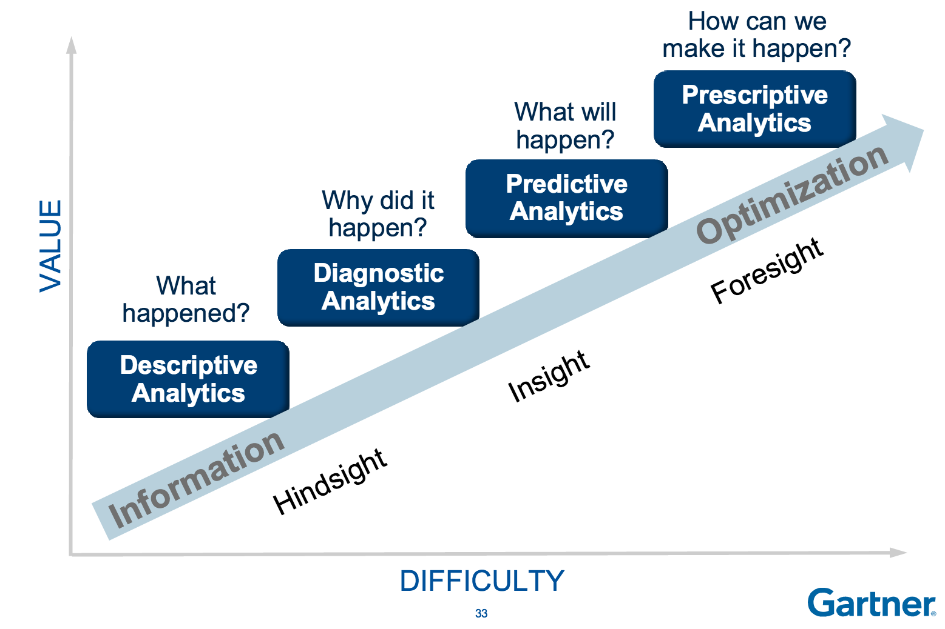
Notes:
Alright, so some of you may have seen this chart before. This visual was popularized by Gartner as a way for companies to assess their level of data maturity. The further your company climbs toward the right side of the chart, the more complex the methods become, and the more mature your organization’s data efforts are.
In reality, many companies, including my own, have a mix of these methods. For example, a company like Amazon might use descriptive analytics for it’s financial reporting – those are very much focused on the here and now. They might also use diagnostic tests like A/B testing to measure UI changes to their app. They might also use predictive analytics to forecast sales and prescriptive analytics to optimize routes for their delivery drivers. Data maturity can vary within departments, across subsidiaries, or even across individuals within the same team.

Slide 4

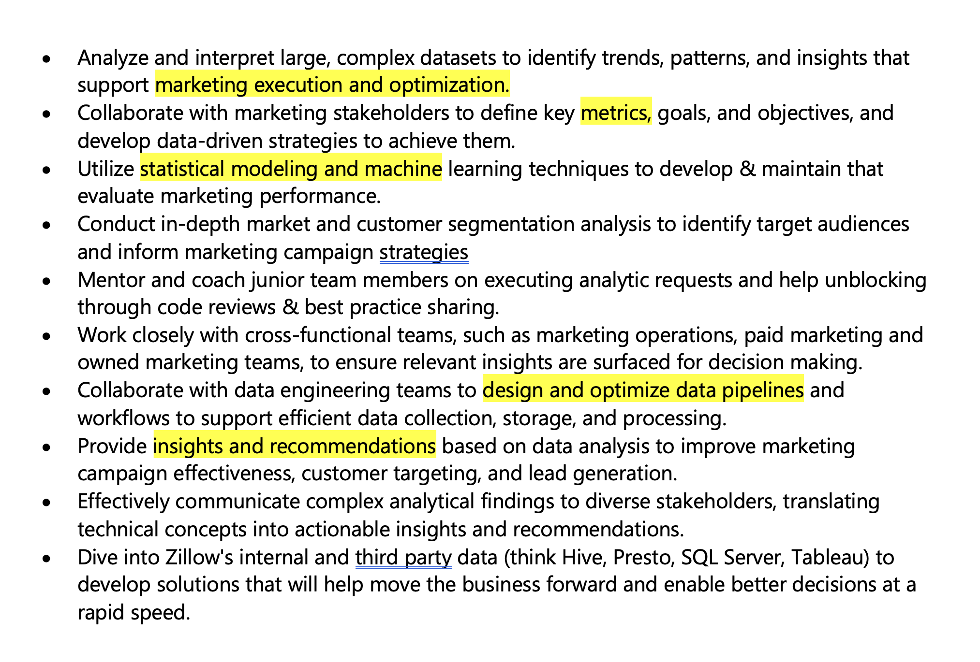
What does this mean for me?
Data Science jobs are not one size fits all
Problems are complex and often require a combination of methods to be solved
Organizations with a less mature data structure and/or small teams are especially prone to lacking specialized roles
Notes:
So, how does this chart relate to you all? If you’re already in the field of data science, you’ve likely already experienced this - but more often than not, employers will expect and require you to have a mix of the skills that fall under those buckets.
I found this job description for a Senior Data Scientist at Zillow last week - Notice how just in this one job description, Zillow is requesting that the candidate has skillsets from each of the pillars of data maturity. Problems that data scientists solve are complex and often require a combination of methods to be solved.

Slide 5
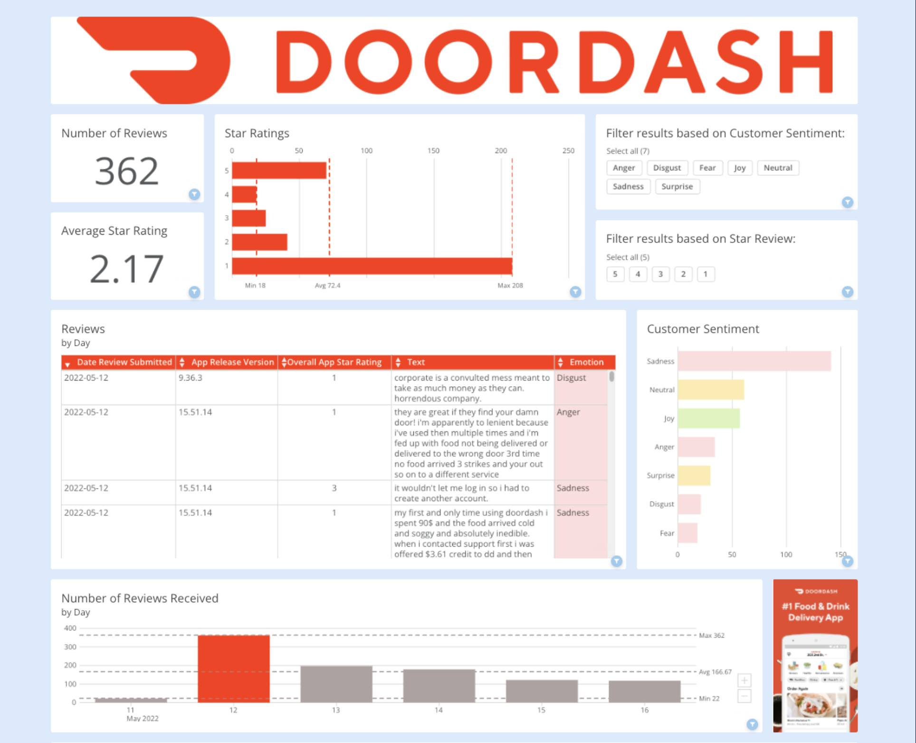


Use Case: Using NLP to analyze customer reviews
Notes:
So, what’s this, you may ask?! Another thing that companies ask for in job descriptions, and often inquire about in interviews, are end to end projects you have completed.
This screenshot is an example of a personal project I made analyzing DoorDash’s app stores reviews. In this dashboard, I aimed to measure customer satisfaction through both quantitative and qualitative methods. This project is a great example of a real-world problem that a company might aim to solve that requires multiple skillsets to accomplish. Using an NLP model from Hugging Face, which is a hub for various Machine Learning and Artificial Intelligence models and Domo’s Jupyter Workspaces tool and its data visualizations, I was able to complete an end to end project on my own, without having an entire team or resources dedicated to solving it.

Slide 6
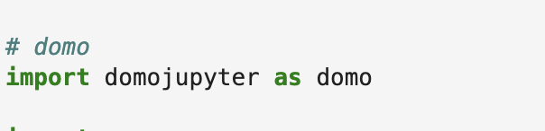
What is Jupyter Workspaces?
A way to use Python directly inside of Domo, without having to leave the platform.
Use an existing dataset or create one from scratch
Perform data cleaning and modeling
Set up your notebook on a scheduled refresh
Save your dataframe as a new or updated dataset to Domo
Elevate your insights and visuals!
Notes:
Before we get more into today’s use case, I’d like to provide a background for what Jupyter Workspaces is for those of you who may not have heard of it yet.
It is a way to use Python directly inside of Domo, without having to ever leave the platform. As I mentioned earlier, I am a Business Intelligence Analyst turned Data Scientist – so this tool is PERFECT for users like me who want to combine BI with the advantages of open source programming languages like Python.
Start with an existing Domo dataset or create your own from scratch – and then perform your data cleansing and modeling as you normally would in a Jupyter notebook by importing the domo Jupyter package.

Slide 7
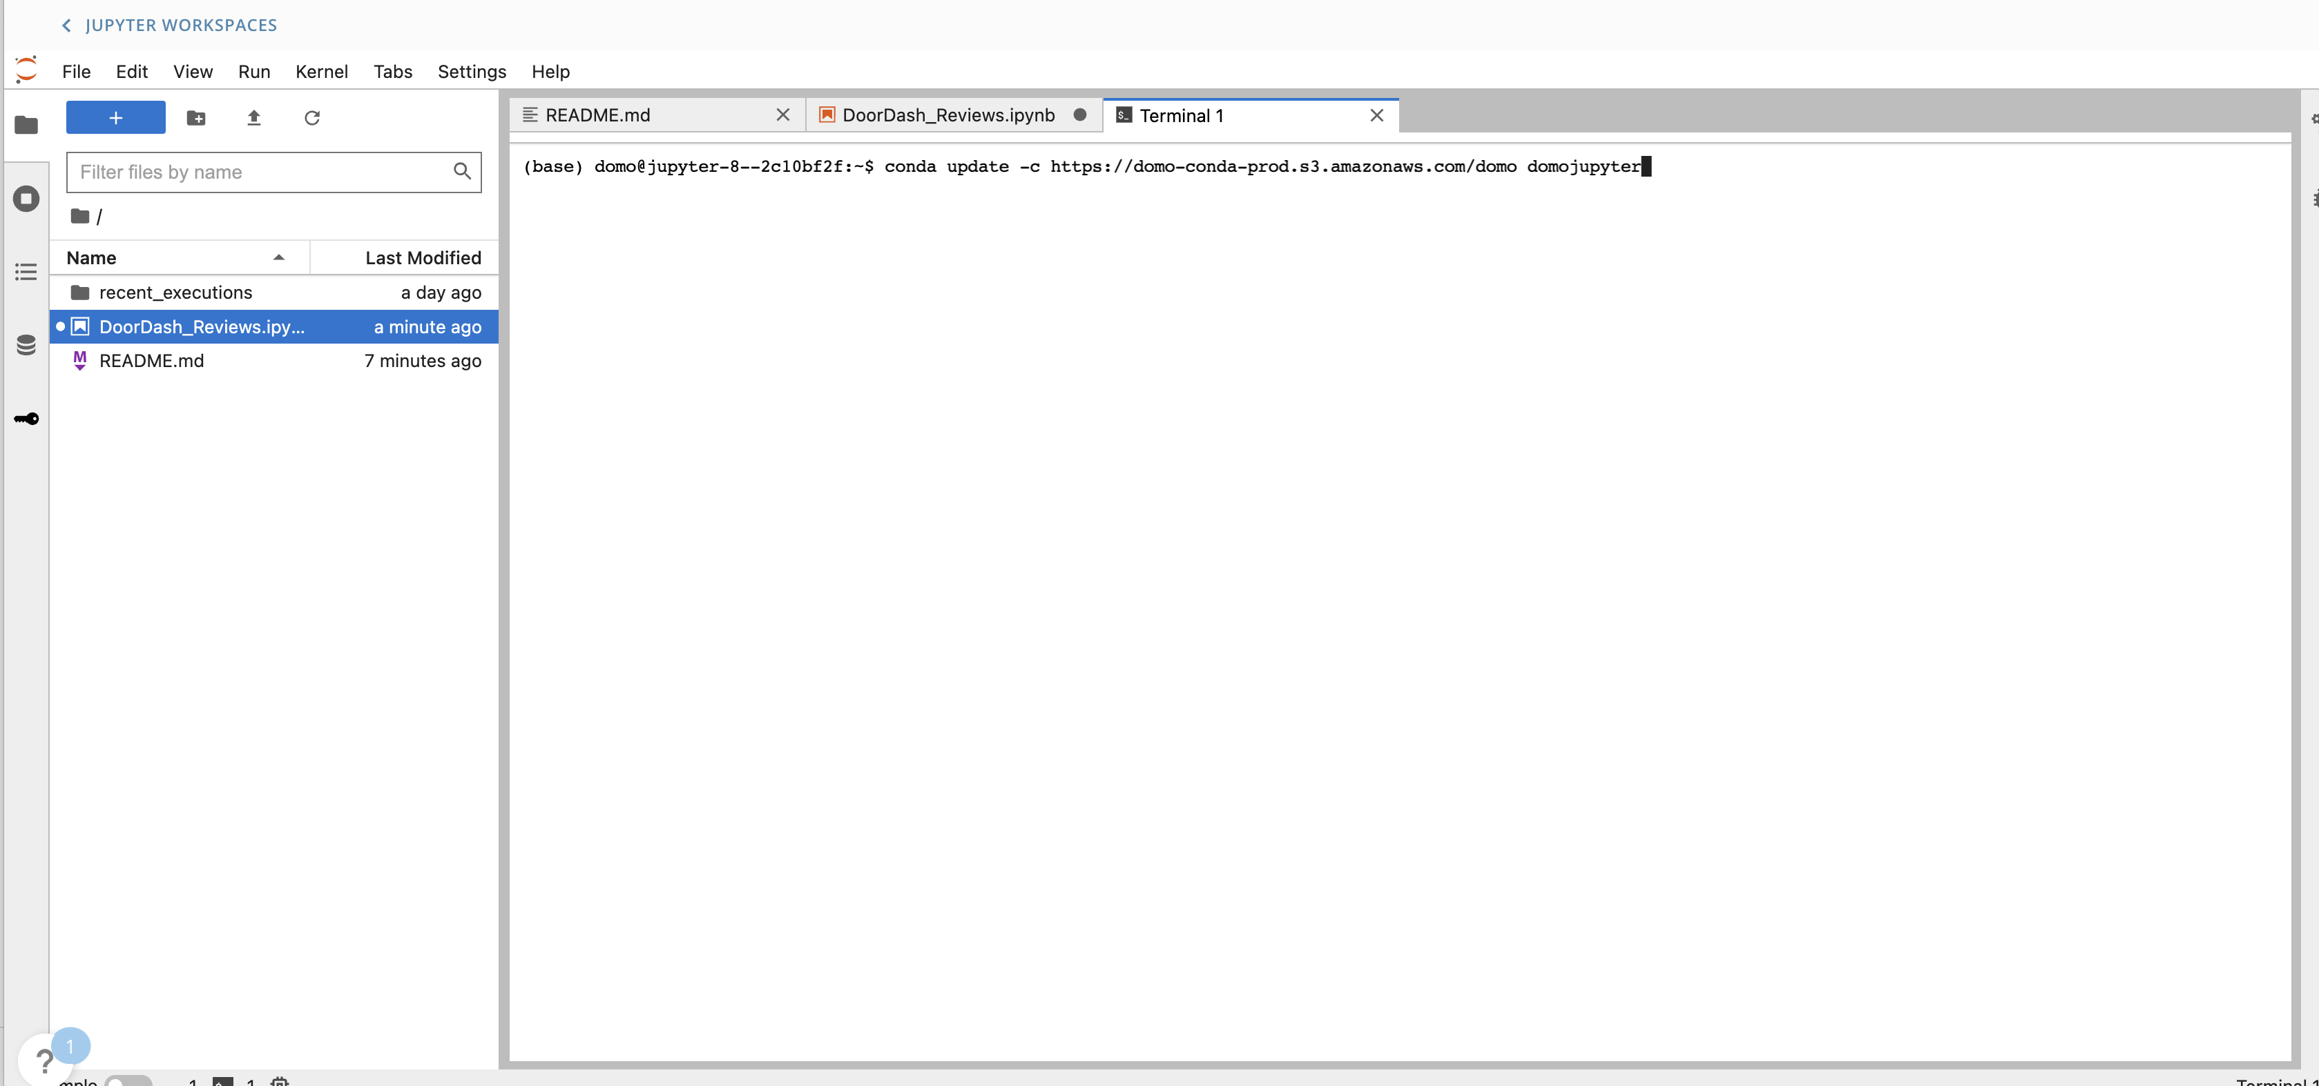
Getting Started: Creating your environment
Notes:
Getting Started
The first step to any data science project is setting up your environment and importing necessary packages. Just like on your local computer, you can create an environment for each Jupyter workspace within the Terminal. On the left hand side, you can see that there is also a README file that is ready for use to provide a summary of the project and documentation for future readers. At this point, you’re already demonstrating that you can set up an environment and work well with a command line interace.

Slide 8
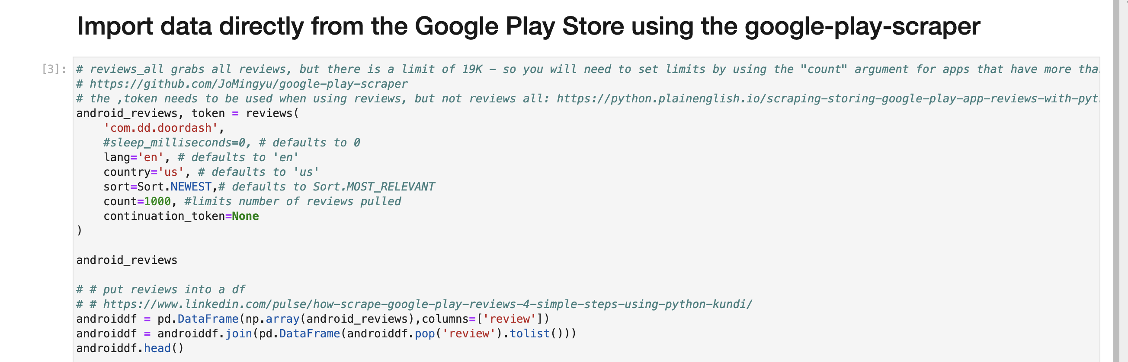
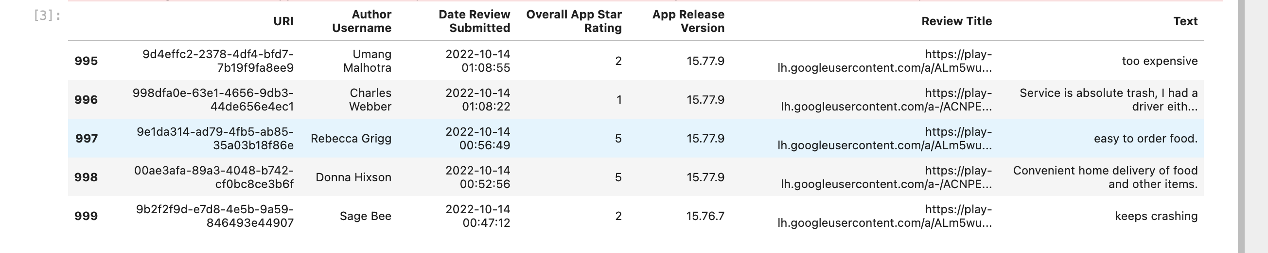
Notes:
Next, we have our Data import. This is arguably the most important phase in the data maturity pipeline that wasn’t even shown on the Gartner chart – but in order to do ANY type of analytics, whether you are doing descriptive, diagnostic, predicitive, or prespective analytics, you need to extract and transform relevant and accurate data from trusrtworthy data sources.
Typically in an organization, data ingestion pipelines are created and maintained by data engineers or database administrators. But here, I am doing it all myself using the google-play-scraper Python package. Again, this dataset is created from scratch, although you can import existing domo datasets here as well.

Slide 9
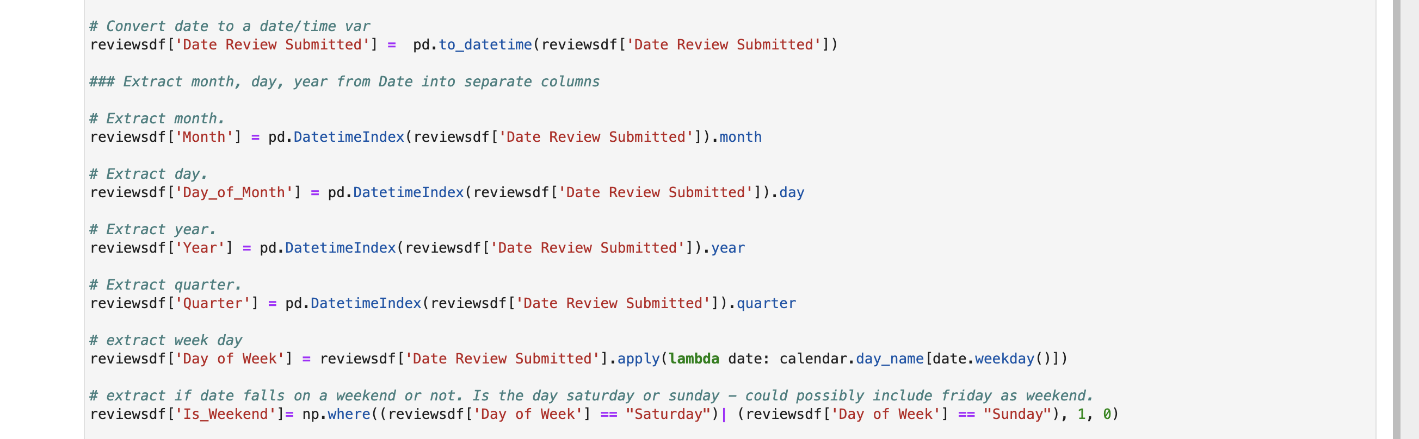
Notes:
Perform manipulations as you normally would in python

Slide 10
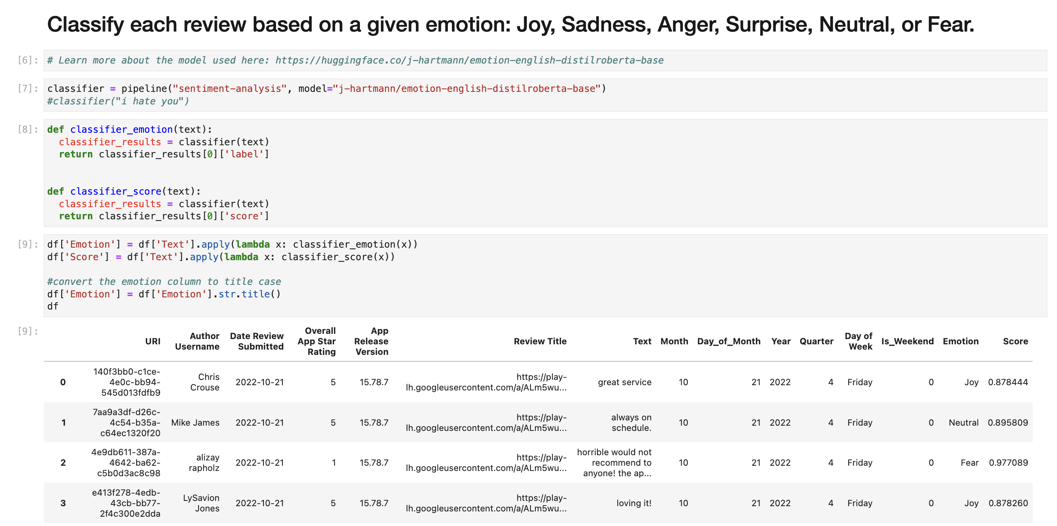
Notes:
Now to the fun part - Applying the NLP model!
The model I’m using here is DISTIL ROBERTA BASE, which is a Hugging Face model pre-trained for emotion classification tasks. Outside of emotion classification, Hugging Face hosts numerous other models that may better fit your particular use case. As you can see in the Emotion column on the far right, each review is analyzed and a specific emotion is applied. One of the advantages of Hugging Face is that many of their models can be implemented using only a few lines of code, which I’ve demonstrated above. This is an example of diagnostic analytics.

Slide 11
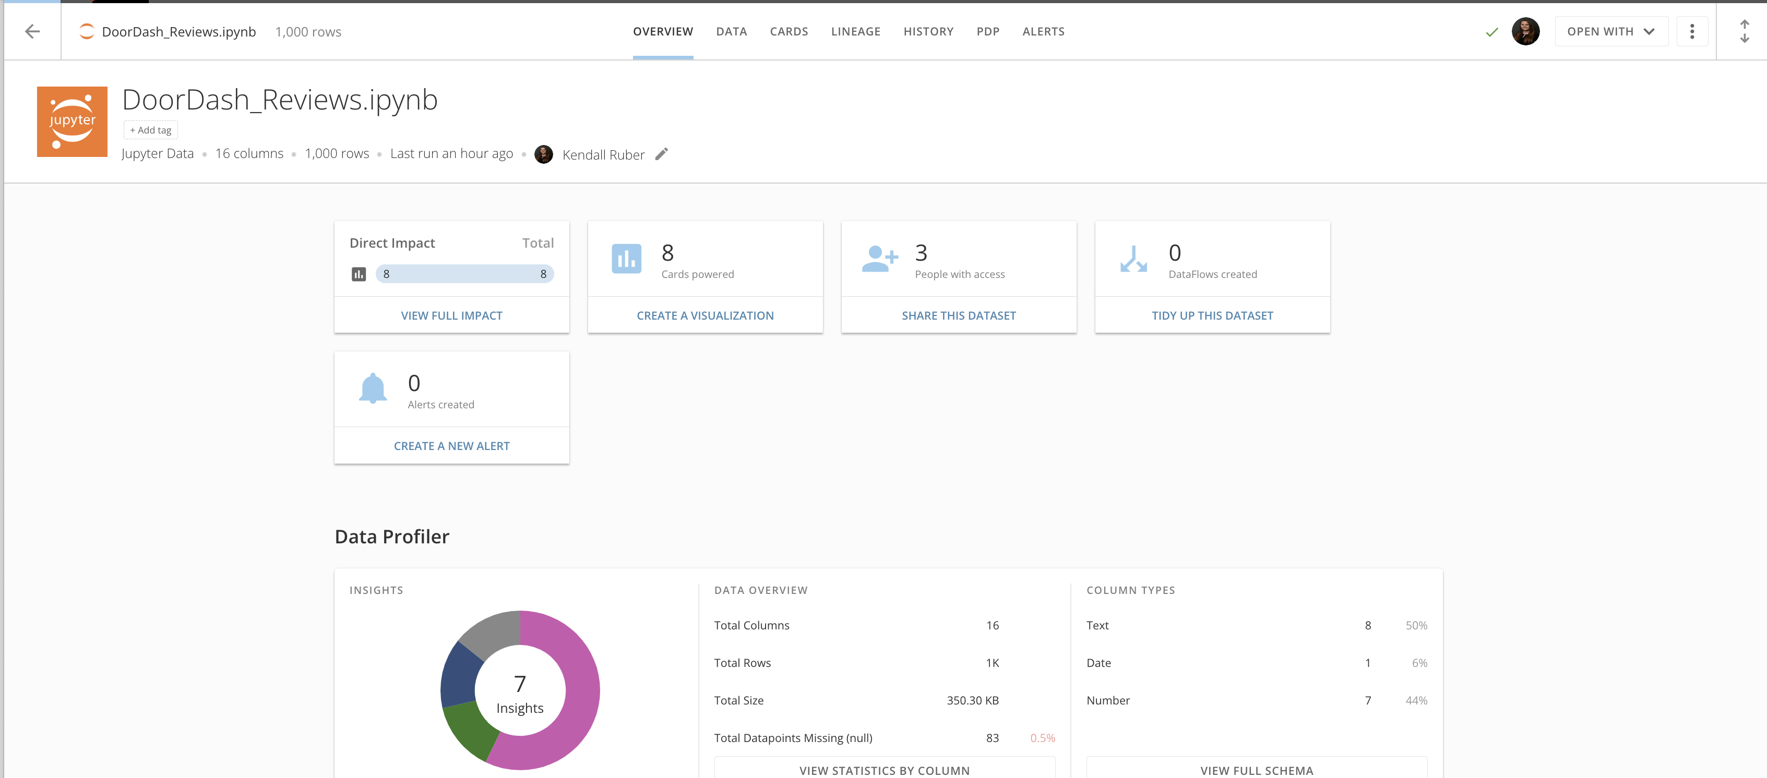
Notes:
Write back to domo
Now that we’ve completed all of our operations and applied the emotion detection, we finish the pipeline by writing the data frame to Domo as its own dataset. To write this dataset back to Domo as a dataset, use domo jupyter’s write_dataframe command.

Slide 12
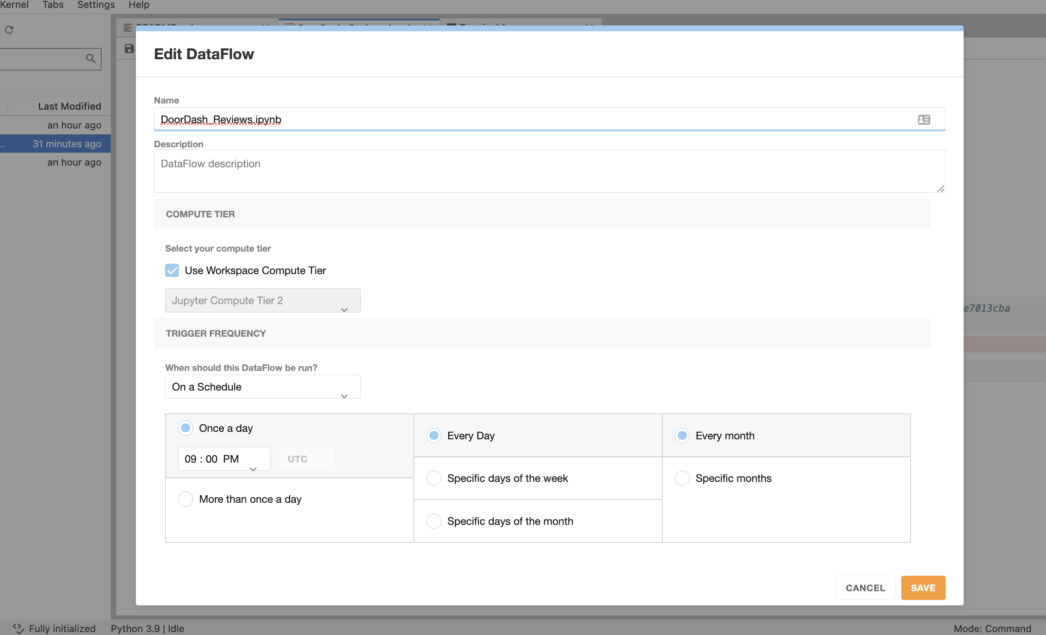
Notes:
BONUS: Schedule your notebook to refresh on a recurring basis
And last, but certainly not least, like any domo dataset, you can set up your jupyter notebook to refresh on a recurring basis, so you always have the most up to date insights!
Here, you go into the Edit DataFlow component and can set your notebook to refresh on a weekly, monthly, or daily basis, or even refresh multiple times per day if you’d like. To me, this is one of the most impactful benefits of the tool – I have not seen similar functionality present in Domo’s competitors.

Slide 13
Notes:
Now that we have our dataset, we can complete the last mile of this project by creating data visualizations using descriptive analytics that highlight key performance metrics like the star rating, the total count of reviews, and number of reviews collected over time. Once I incorporate corporate colors and branding to finish off the design, I now have an interface where leaders with any level of data literacy can go to get a high level overview of the DoorDash app performance.

Slide 14
Skills demonstrated:
Command line interface
Python
SQL
Data visualization
Data ingestion
Natural Language Processing
Business Intelligence
Emotion Detection
Metric identification
Communication
Notes:
In summary, from this single project, I’ve demonstrated that I’m skilled in a variety of areas that can be applicable to many different data roles.

Slide 15
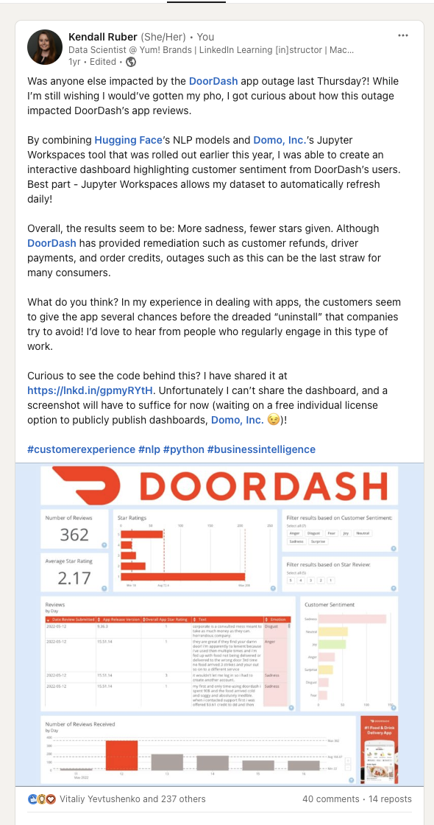
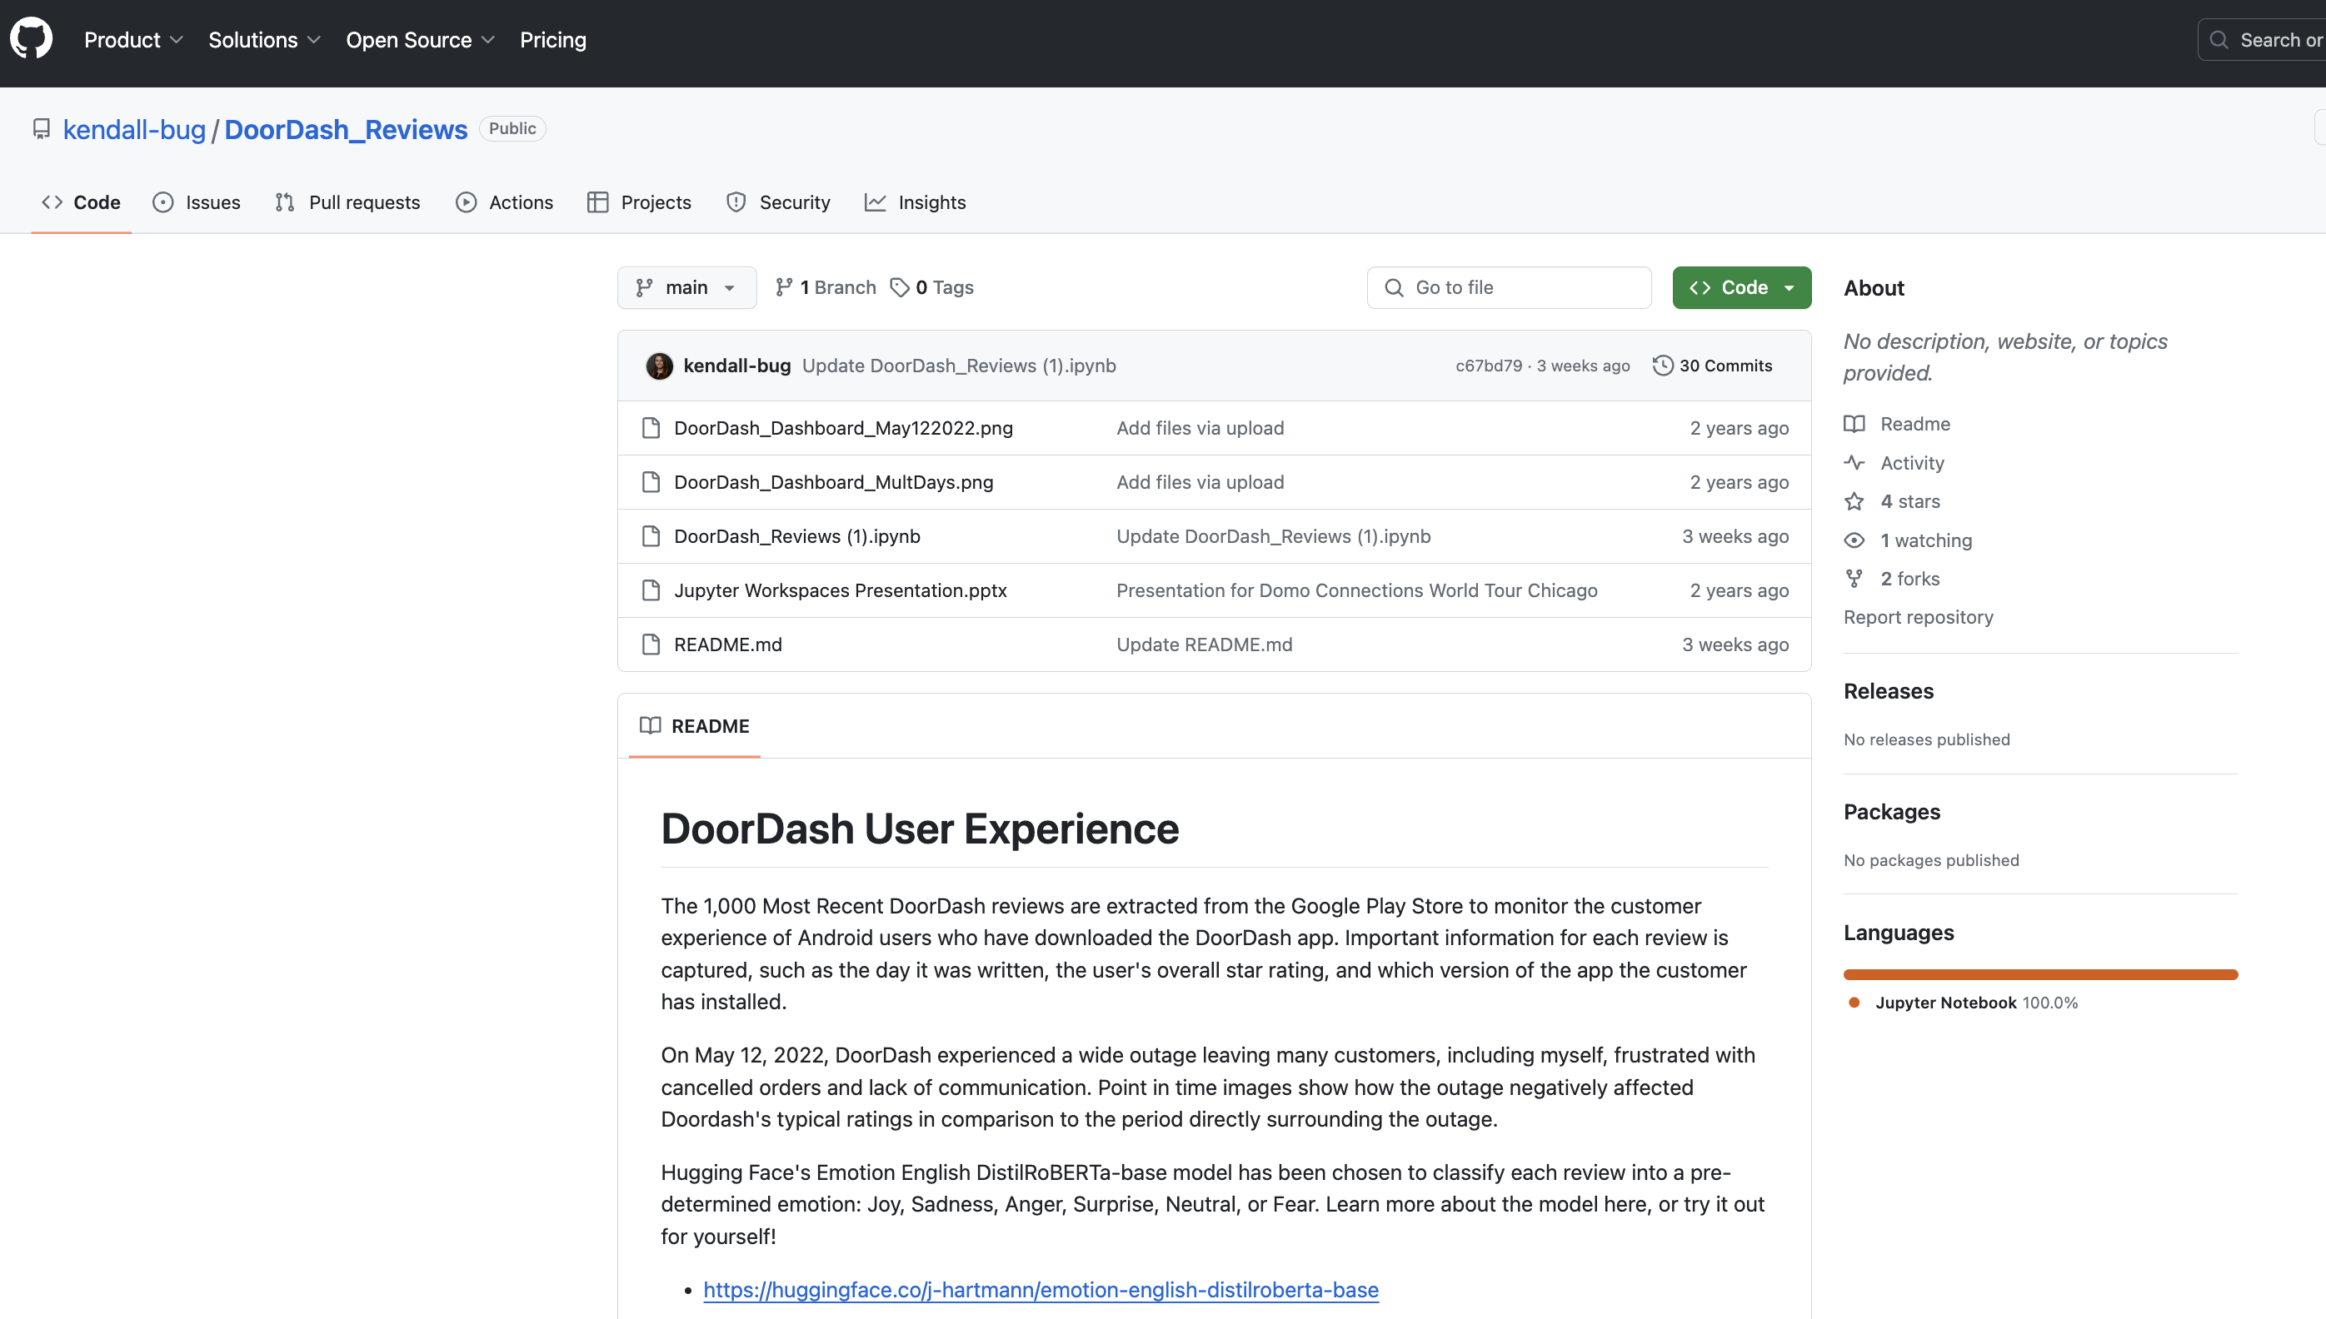
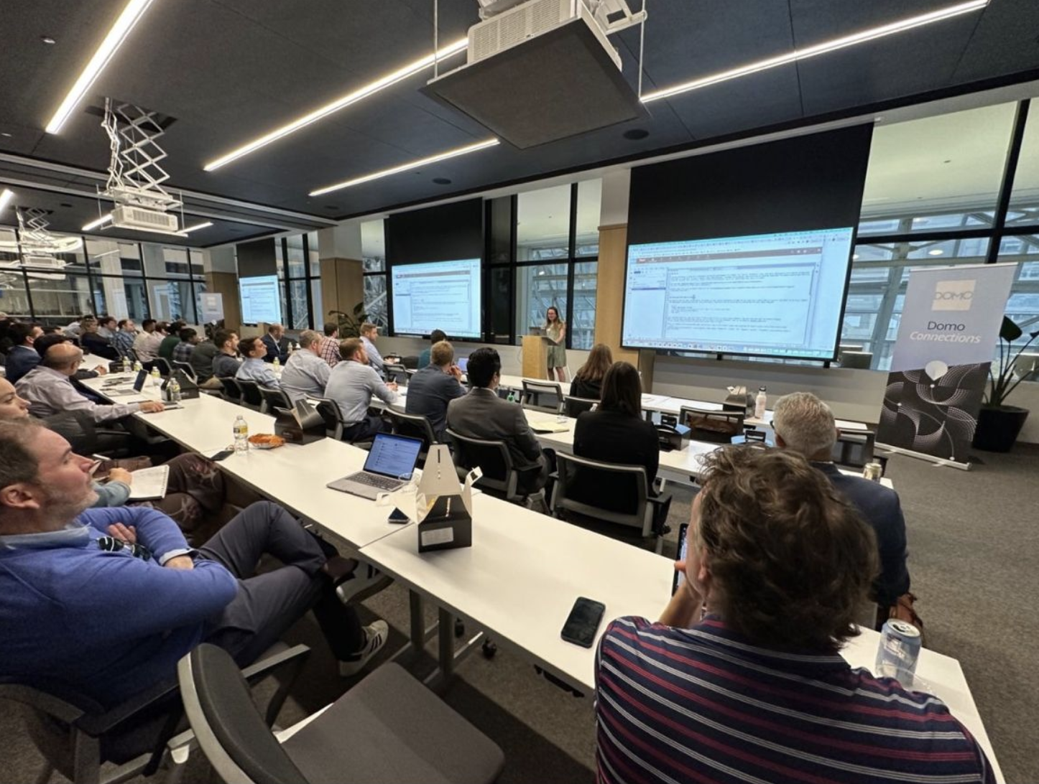
Show your work!
Portfolio Project
Social Media
Conferences & Public Speaking
Notes:
Before closing out, there’s one more thing I want to talk about that is especially relevant to you all as students who might be hitting the job market soon. And that’s the importance of sharing your work with others! Now, you can’t exactly go around sharing proprietary code you’ve used at your company – but what you can do is share personal projects like this! This is a way to not only promote your skillset and help you to find like-minded peers, but it is also a way that a future company can see that you are a self starter who is equipped with the drive to be a lifelong learner. If you’re looking for your first data job, this can also be a way for an employer to feel like you are a “less risky” hire.
I primarily share my work through LinkedIn, GitHub, and speaking opportunities like this one! You’d be surprised at how far these types of projects can take you. I actually made this project about 2 years ago. And from that, I have created a successful LinkedIn post with over 80,000 impressions, have gotten to travel to two states with Domo, and presented my work at one of their conferences in Chicago. It’s a good way to force you to keep your skillset relevant and put you in environments where you meet other talented individuals, and could potentially be a talking point in future interviews for me!

Slide 16
Questions?
Additional Resources:
Underlying Code and PowerPoint Slides:
https://github.com/kendall-bug/DoorDash_Reviews
Hugging Face Model:
https://huggingface.co/j-hartmann/emotion-english-distilroberta-base
Instructions for how to set up your own Jupyter Workspace:
https://domohelp.domo.com/hc/en-us/articles/360047400753-Jupyter-Workspaces-Beta-
https://domopalooza2022.brandlive.com/home/en/session/10a98144-9651-11ec-95c3-9349e7013cba

